Slide 1

Project EA Sports - FIFA
CS109a Final Project
11 December 2020
Group 4 – Clement Brenot, Luis Corrales, Ryuichiro Hashimoto, Yuki Yaguchi

Slide 2

Agenda
Overview
Part A – Rank the Players
Part B – Classify Player Position
Part C – Which Club has the Best Staff?
Part D – How Things will be in 2021?
Possible Future Improvements

Slide 3
1. Overview

Slide 4
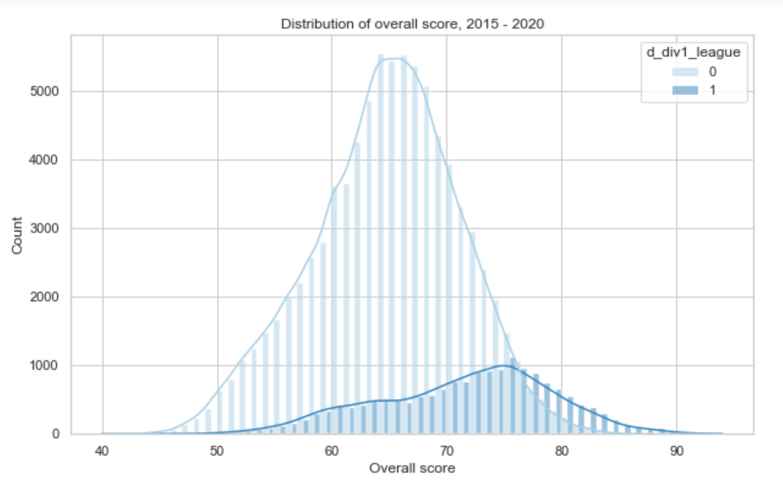
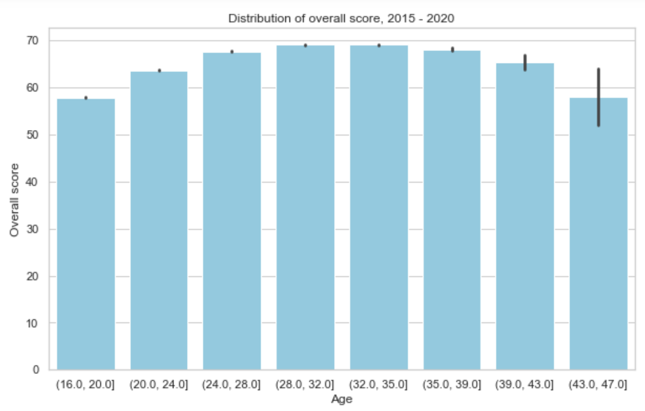
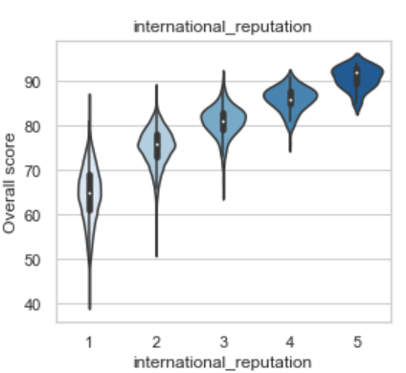
Data and Selected EDA Results
Overview
Part A
Part B
Part C
Part D
Data pre-processing
Raw
Data
5 files
104 variables
Merge
One-hot encode
Simplify & clean
Impute
Standardize
Pre-processed data
1 dataset
100,995 x 146
Raw
Data
5 files
104 variables
Raw
Data
5 files
104 variables
Raw
Data
5 files
104 variables
Raw
Data
5 files
104 variables
A good overall score? 75 and up
Old players decline… but not always
International reputation is a guarantee
75

Slide 5
2. Part A – Rank the Players

Slide 6
Methodology
Overview
Part A
Part B
Part C
Part D
Pre-processing
Model creation
Final model
Target variable:
Overall (player's overall rating)
Data processing flow:
Model type
Tuning parameters
One-hot-encoding for categorical variables
Ex.) player traits, tags, etc.
Tree parameters
Overall (co)
*co: continuous
XGBoost
XGBoost model is chosen
Regularization parameters
Training dataset:
All players in FIFA 2019 dataset
Evaluation metrics
Test MSE
% of obs within +/- 2
FIFA 2019 dataset
XGBoost
Imputation and
Standardization
Ex.) goal keeping abilities
for field players, etc.
0.68
97.7%
Tree depth
Test dataset: players in the clubs below (FIFA 2020 dataset)
Random Forest
Random Forest
0.72
96.4%
# of trees
FC Barcelona
LASSO
7.99
60.2%
FC Bayern München
Real Madrid
L1 norm parameter
"% of obs within +/- 2" shows the proportion of observations that fall into +/- 2 of predicted overall rating.
LASSO
Paris Saint-Germain
EDA and Regression
Juventus
Manchester City
Hyperparameter tuning using random search with cross validation
Liverpool FC

Slide 7
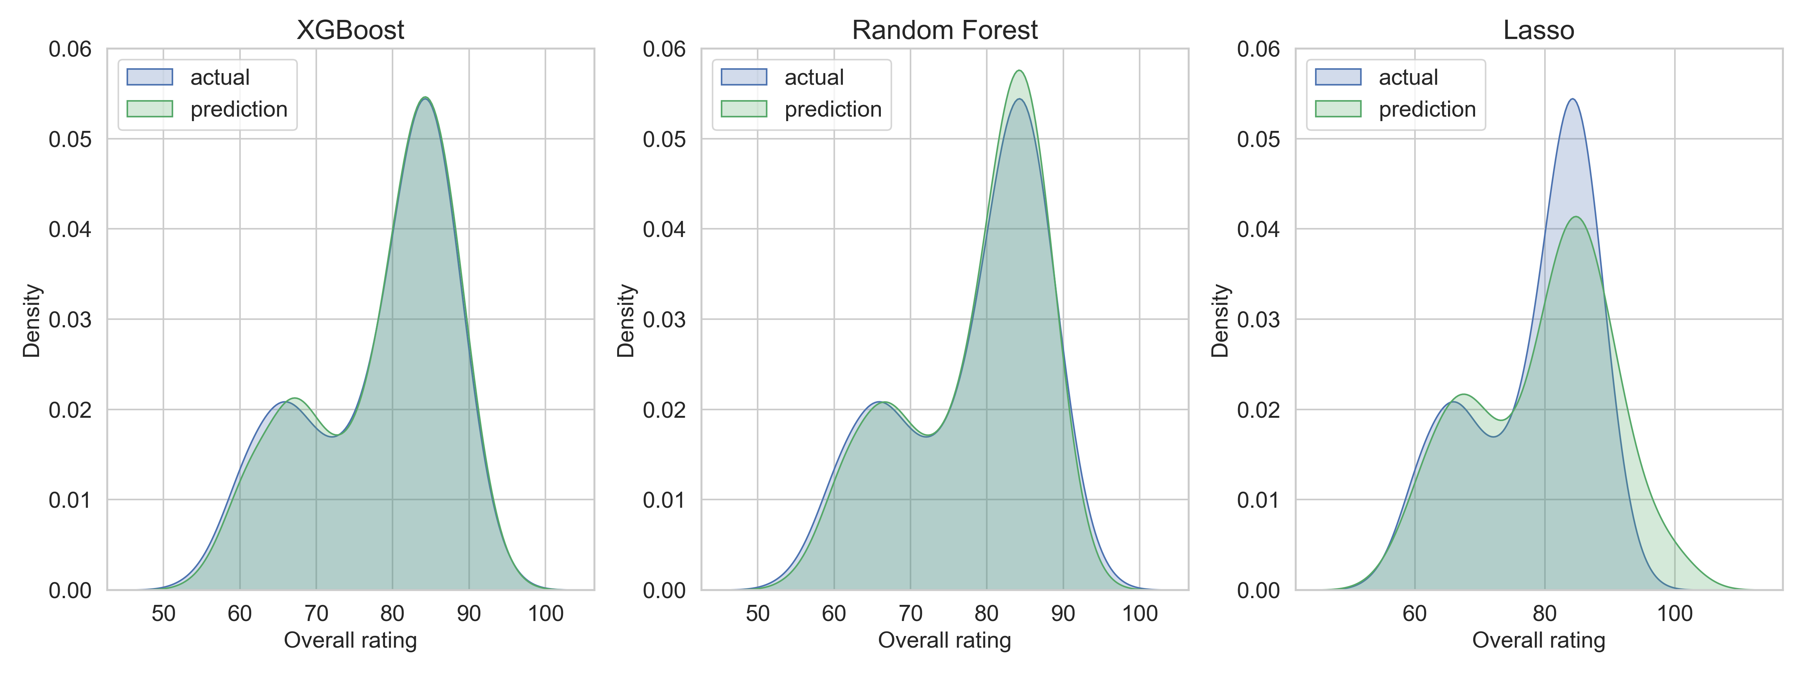
Overall Score in Test Set – Actual vs. Prediction, by models
Overview
Part A
Part B
Part C
Part D
XGBoost almost completely predicted overall ratings for almost all players.
LASSO especially misses the highest range, potentially due to its linear equation form.

Slide 8
3. Part B – Classify Player Position

Slide 9
Methodology
Overview
Part A
Part B
Part C
Part D
Final model
Pre-processing
Model creation
AdaBoost model is chosen
Target variable:
Player position
Data processing flow:
Model type
Tuning parameters
Evaluation metrics: Grouped Positions
Creation of new grouped category of players
Forward, Midfilder, Defender and Goalkeeper.
Ridge-like regularization
Test Accuracy
Precision
Recall
Player position (mc)
Logistic
Logistic
0.951
0.956
0.958
* mc: multiclass
Decision Tree
0.938
0.946
0.945
Decision Tree
Tree depth
AdaBoost
0.962
0.967
0.967
XGBoost
0.958
0.959
0.967
Training dataset:
All players in FIFA 2019 dataset
Drop of Variables that bias the sample
Ex.) goal keeping abilities
only available for goalkeepers and missing values for the rest
Random Forest
0.962
0.963
0.958
FIFA 2019 dataset
AdaBoost
Tree depth (same as Decision Tree)
Evaluation metrics: All Positions
Test Accuracy
Precision
Recall
Hyperparameter tuning using random search with cross validation
Logistic
0.865
0.783
0.720
XGBoost
Decision Tree
Test dataset:
All players in FIFA 2020 dataset
0.826
0.687
0.616
Classification
AdaBoost
0.885
0.838
0.753
FIFA 2020 dataset
Random Forest
Tree depth
XGBoost
0.883
0.799
0.792
Random Forest
0.868
0.816
0.715

Slide 10
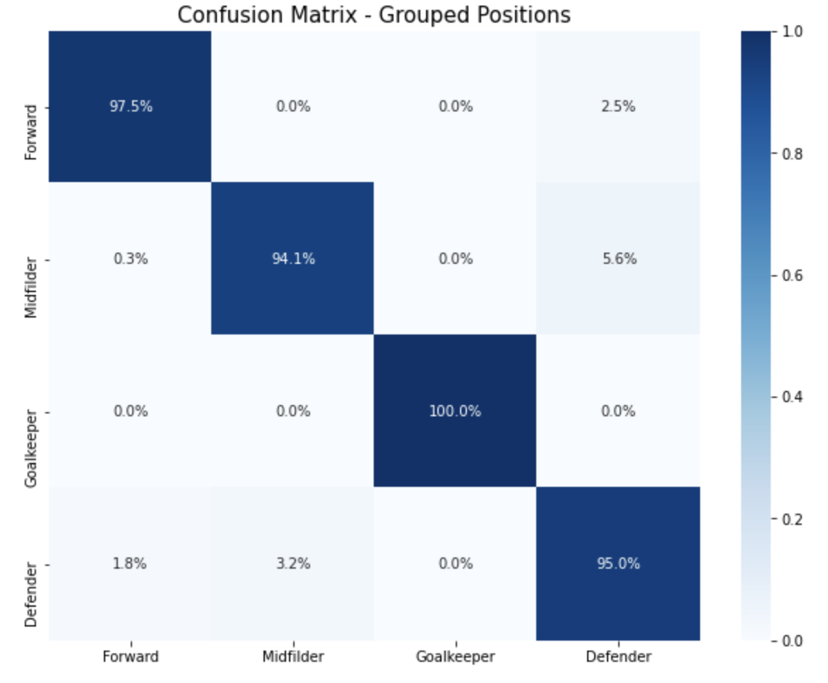
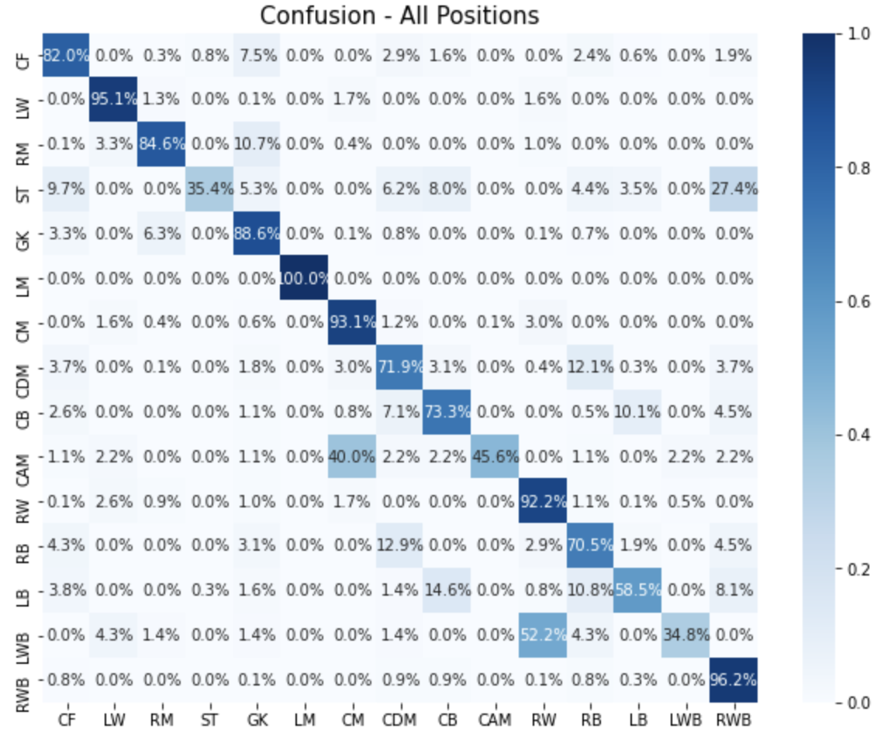
Confusion Matrix for Predicted Positions
Overview
Part A
Part B
Part C
Part D

Slide 11
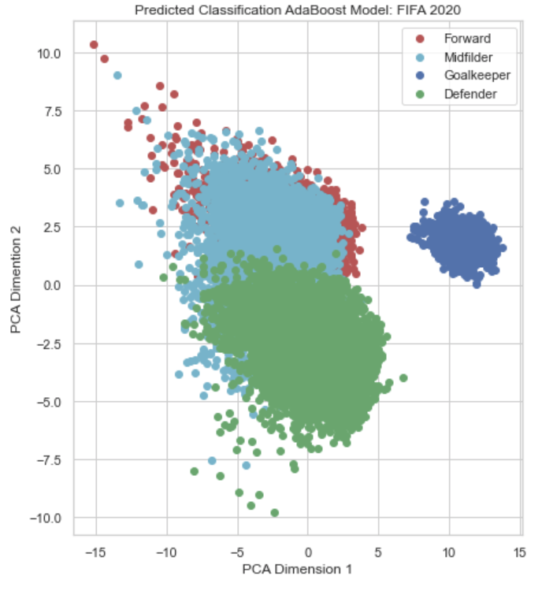
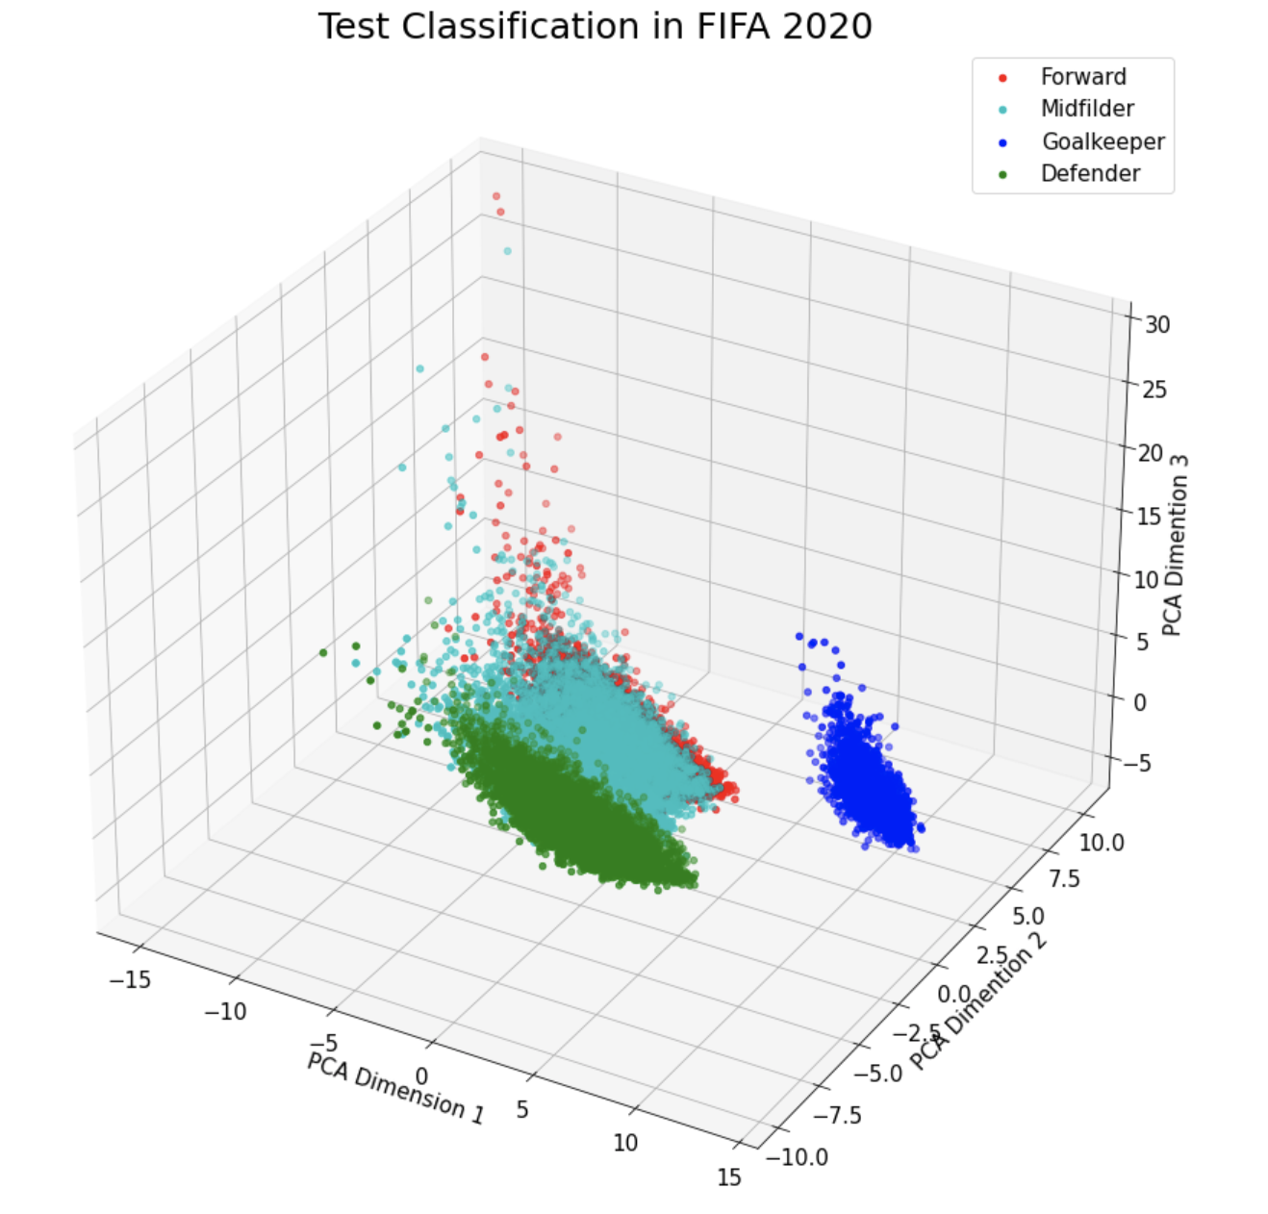
PCA components of Grouped Positions: 2 and 3 Components
Overview
Part A
Part B
Part C
Part D

Slide 12
4. Part C – Which Club has the Best Staff?

Slide 13
Methodology
Overview
Part A
Part B
Part C
Part D
Pre-processing
Model creation
Ensemble
Final Output
Target variable:
Annual change in 5 category
Model type
Training variables
Compute variable importance of club dummies for each model
overall rating (co)
overall rating
XGBoost
XGBoost
market value
market value (co)
technique
Random Forest
Variable importance:
Avg difference
in prediction between the club dummy = 1 and 0.
technique (mc)
utility
Injury resistance
LASSO
Total score (Avg of 5 sub-score)
Clubs' overall ability to improve players' values & qualities
utility (bc)
injury resistance (bc)
overall rating
Logistic Regression
*co: continuous, mc: multiclass (1 – 5)
bc: binary class
*utility = whether a player can play in multiple positions
market value
Random
Forest
technique
All feature importance (5 indicators * 3 models) are rescaled to 0-100
utility
Training dataset: teams in the leagues below (2015 – 2020)
Injury resistance
Aggregate variable importance by category
overall rating
overall rating
Premier League
Bundesliga
LASSO
or
Logistic
market value
market value
technique
technique
Overall club performance
Ligue 1
utility
La Liga
Injury resistance
utility
Serie A
Hyperparameter tuning using random search with cross validation
Injury resistance

Slide 14
Scoring Methodology
Overview
Part A
Part B
Part C
Part D
Each sub score (1 – 5) is scaled to 0 – 100 based on variable importance from 3 models.
Total score is the average of sub scores
 | League | Club | Total Score | (1) overall rating | (2) Market value | (3) Technique | (4) Utility | (5) Injury resistance
1 | French Ligue 1 | Amiens SC | 70.9 | 100.0 | 81.4 | 72.2 | 39.2 | 67.4
2 | Italian Serie A | Atalanta | 66.9 | 77.8 | 100.0 | 62.9 | 37.6 | 58.1
3 | English Premier League | Tottenham Hotspur | 62.7 | 57.8 | 60.2 | 72.9 | 62.1 | 67.6
4 | French Ligue 1 | RC Strasbourg Alsace | 61.9 | 52.2 | 75.0 | 93.2 | 30.6 | 62.2
5 | Spain Primera Division | RCD Espanyol | 59.3 | 62.3 | 50.3 | 58.3 | 76.1 | 50.6
: | : | : | : | : | : | : | : | :
94 | French Ligue 1 | Stade de Reims | 38.2 | 12.9 | 16.8 | 59.9 | 33.4 | 58.0
95 | French Ligue 1 | Stade Brestois 29 | 37.8 | 23.4 | 34.6 | 39.9 | 25.5 | 50.1
96 | German 1. Bundesliga | Fortuna Düsseldorf | 35.2 | 18.3 | 35.1 | 33.3 | 15.3 | 57.6
97 | Spain Primera Division | CA Osasuna | 32.6 | 4.0 | 6.3 | 31.9 | 55.7 | 51.1
98 | Spain Primera Division | Granada CF | 28.4 | 0.0 | 0.0 | 40.4 | 31.4 | 52.7
Max | 70.9 | 100.0 | 100.0 | 100.0 | 100.0 | 100.0
Mean | 48.2 | 38.3 | 46.7 | 58.7 | 35.2 | 55.1
Min | 28.4 | 0.0 | 0.0 | 0.0 | 0.0 | 0.0
Standard deviation | 6.8 | 13.5 | 12.9 | 17.2 | 15.8 | 12.7

Slide 15
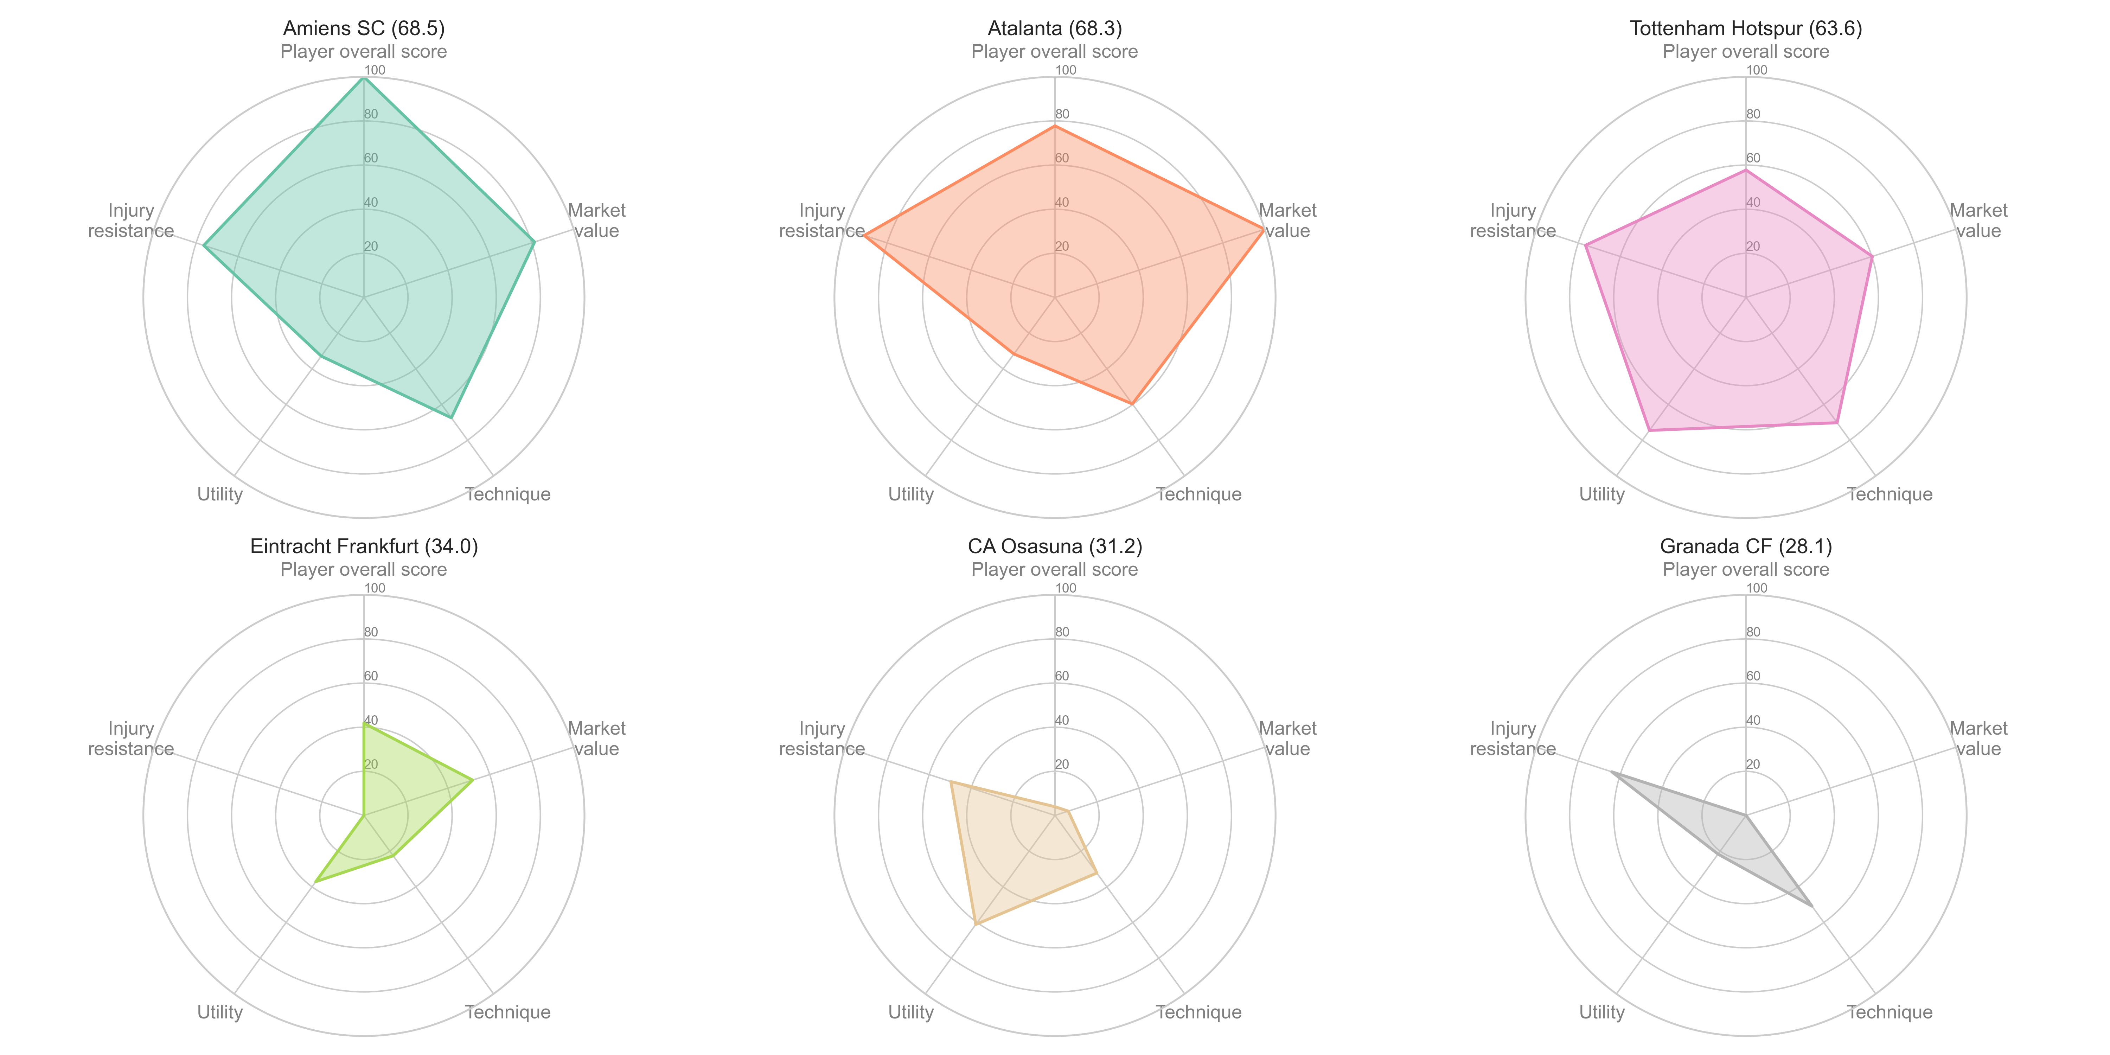
Top 3 clubs vs. Bottom 3 clubs
Overview
Part A
Part B
Part C
Part D
Amiens SC scores the best in player overall score, while Atlanta improves market value.
Bottom 3 clubs' performance are poor, especially for these two metrics.

Slide 16
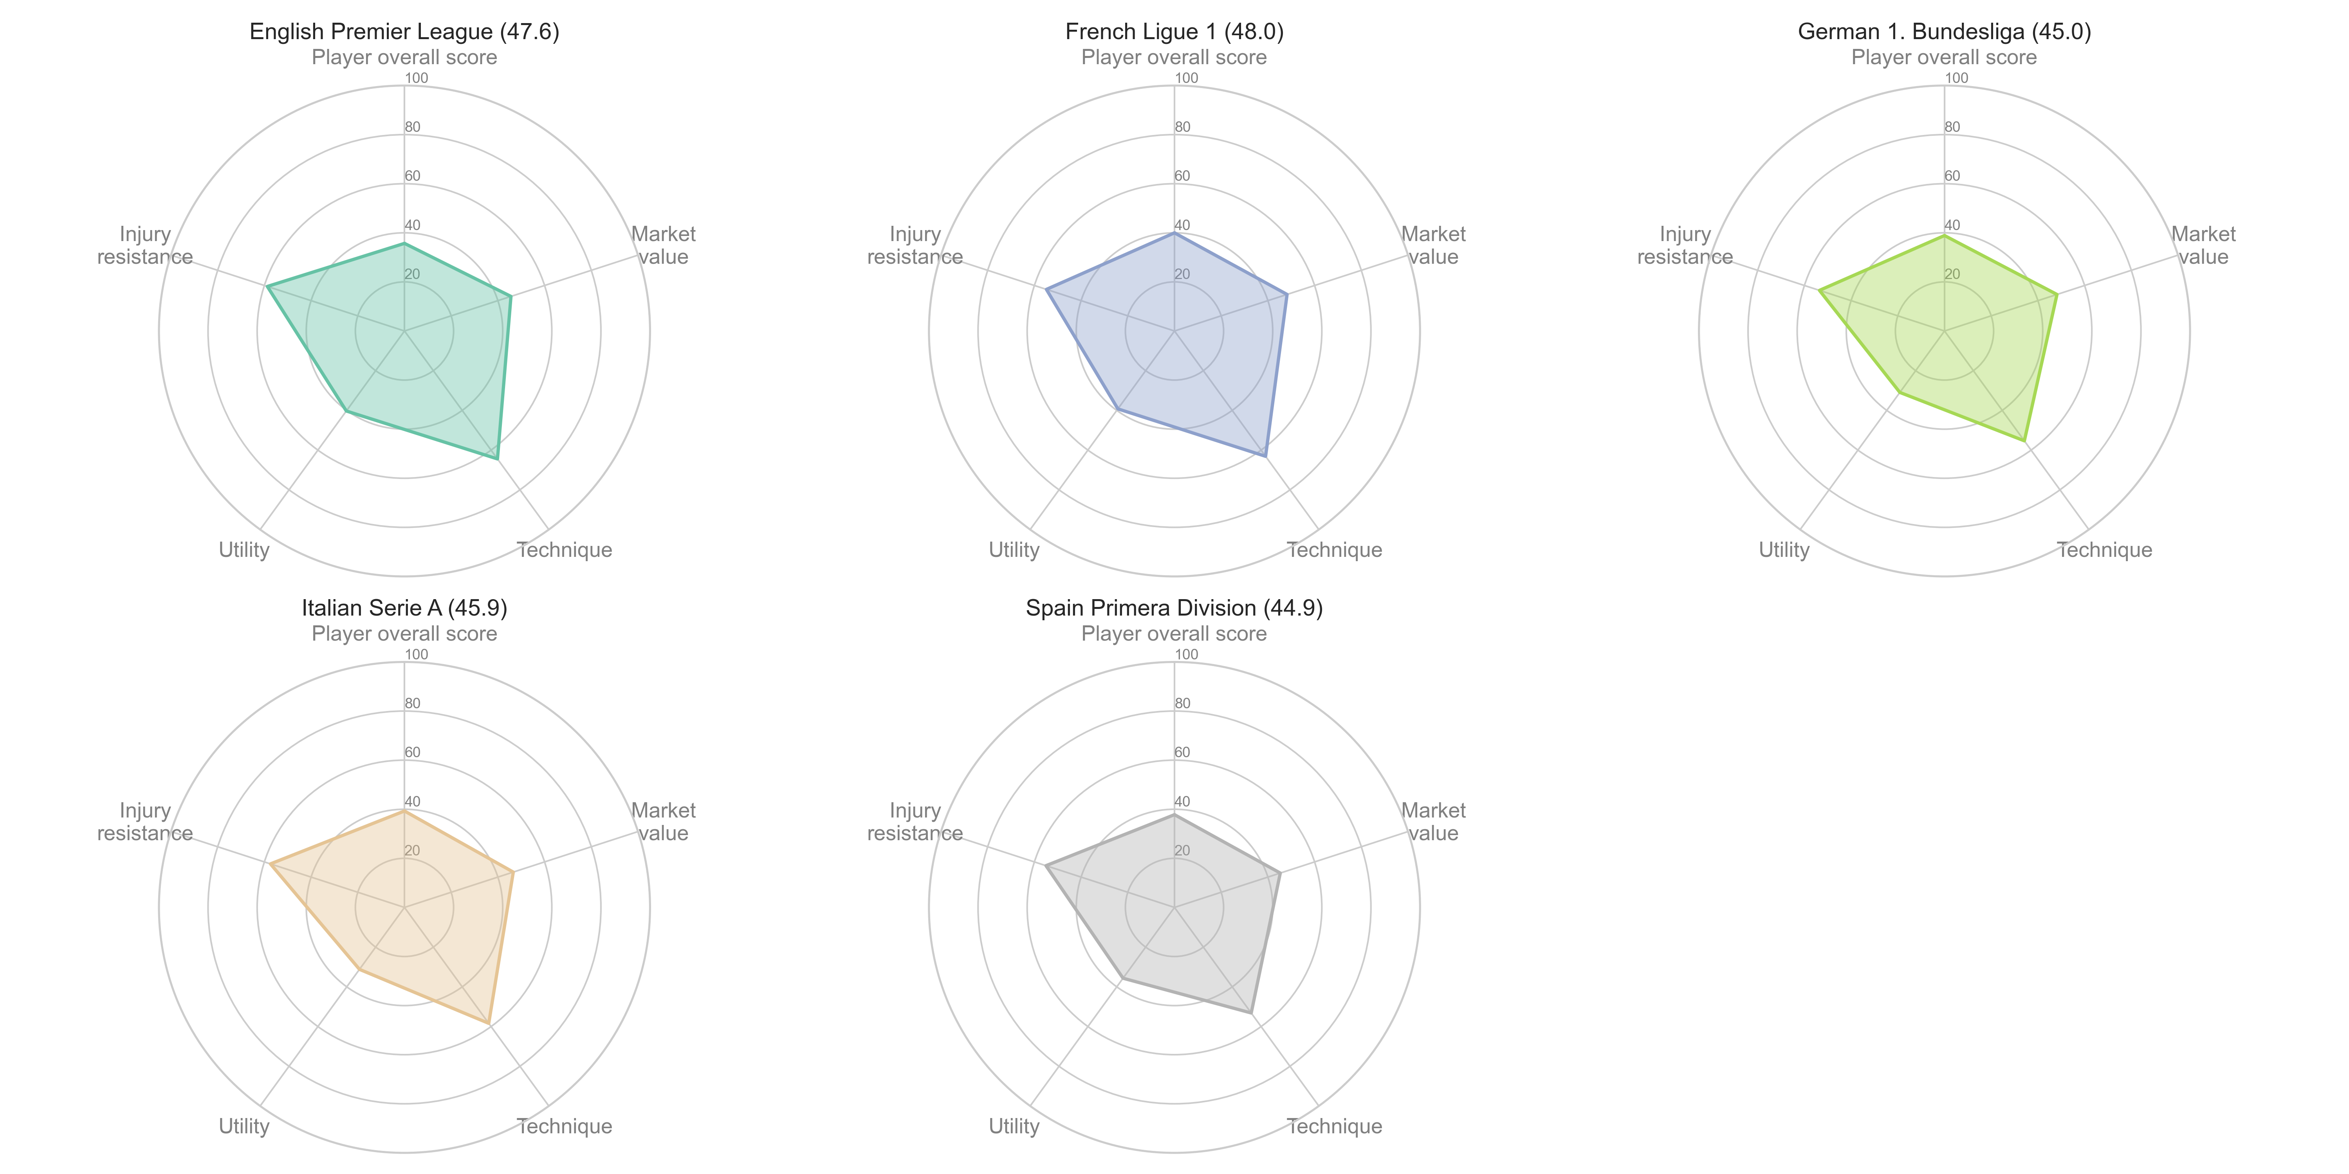
League Average
Overview
Part A
Part B
Part C
Part D
English Premier League and French Ligue 1 are, on average, better than other 3 leagues.

Slide 17
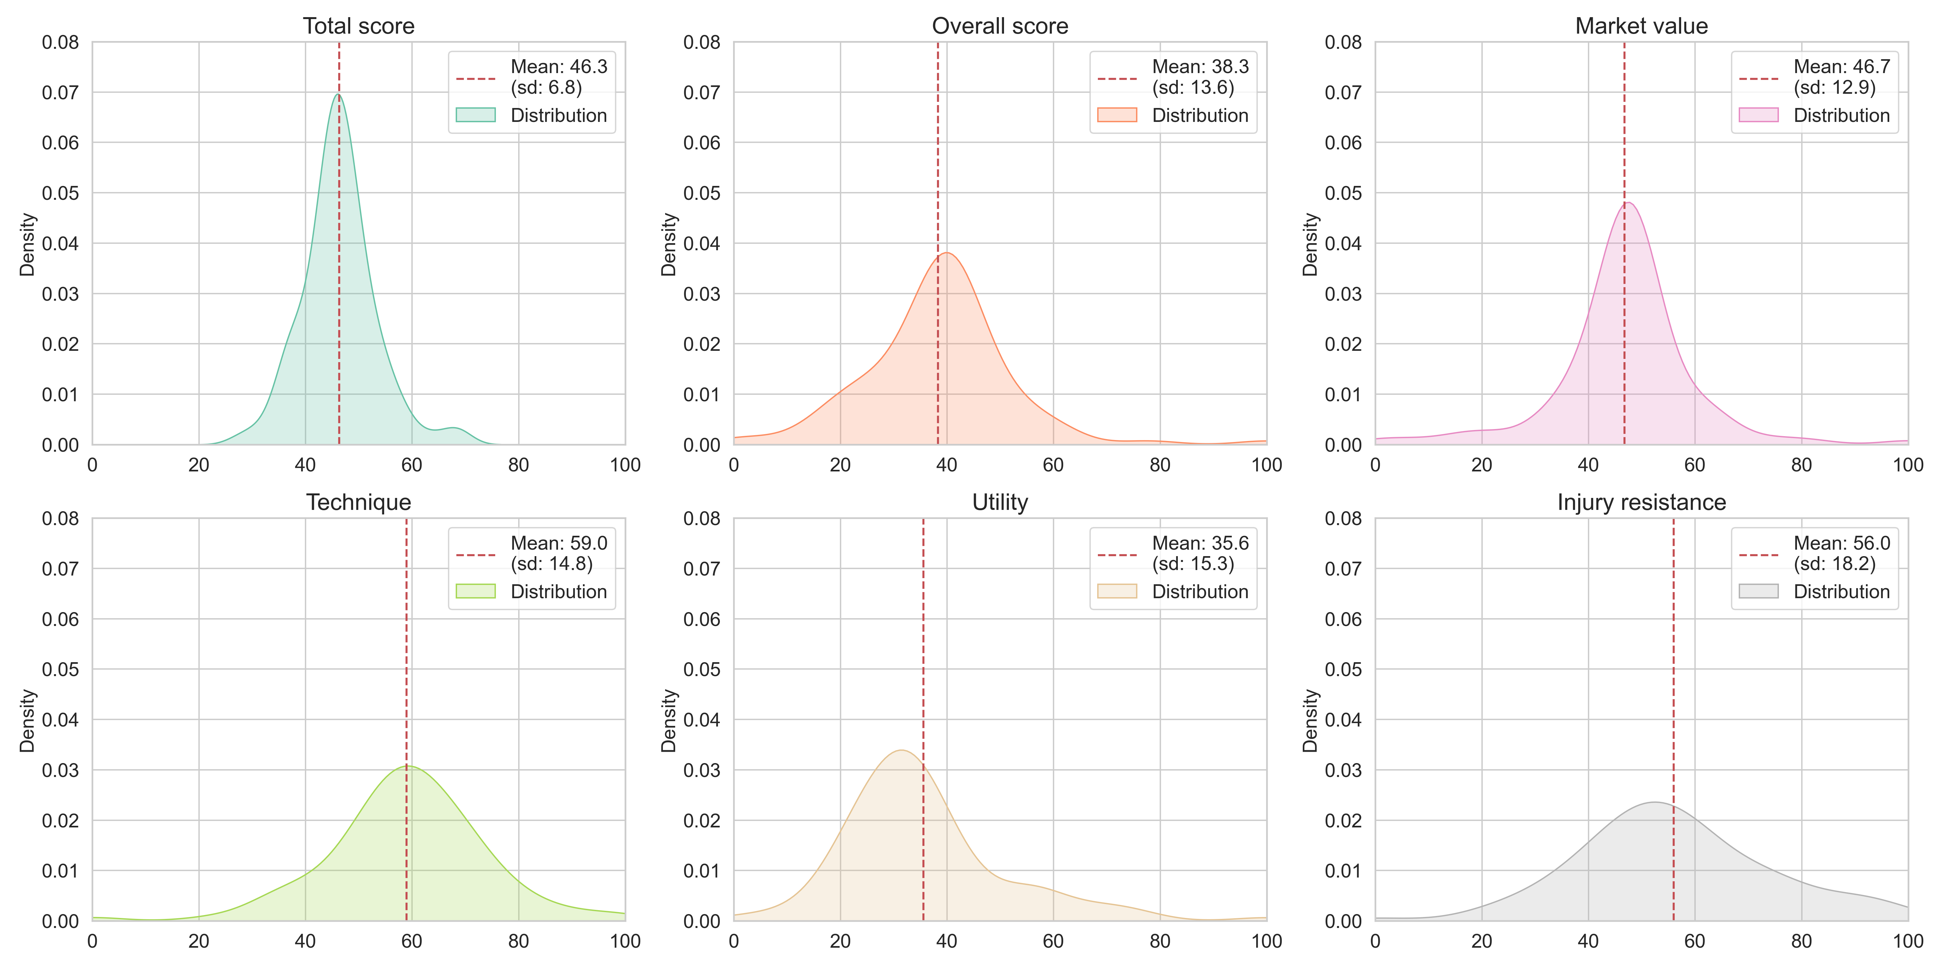
Score Distributions
Overview
Part A
Part B
Part C
Part D
Technique and Utility have a wider distribution than other scores.

Slide 18
5. Part D – How Things will be in 2021?

Slide 19
Methodology
Overview
Part A
Part B
Part C
Part D
Pre-processing
Model creation
Ensemble
Final model
Model type
Training data
Weight by year of training data
Target variable: skill_summary(average of all skills) of the following year
2015 / 2016
2015 / 2016
0.15
2016 / 2017
XGBoost
2017 / 2018
2016 / 2017
0.15
dribbling
Average
2018 / 2019
0.20
curve
2019 / 2020
2017 / 2018
free-kick accuracy
skill
summary
2018 / 2019
0.20
Ensemble of 15 models
Predict on 2020 dataset to predict skill_summary score in 2021
long passing
2015 / 2016
2019 / 2020
0.30
ball control
Average
2016 / 2017
Random Forest
* Model trained on recent year had lower test MSE in general.
2017 / 2018
Training dataset: teams in the leagues specified in instruction (below)
2018 / 2019
2019 / 2020
Weight by model
Premier League
XGBoost
0.30
Bundesliga
2015 / 2016
Elastic Net
2016 / 2017
Random Forest
0.40
Ligue 1
2017 / 2018
La Liga
2018 / 2019
Elastic Net
0.30
Serie A
2019 / 2020
Hyperparameter tuning using random search with cross validation
* Result (better to worse): Random Forest > Elastic Net > XGBoost

Slide 20
The model result (test MSE score)
Overview
Part A
Part B
Part C
Part D
Test dataset: skill_summary score in 2020 predicted by data in 2019
Above number in each cell is test MSE score, the number below is its weight in the entire 15 models (%)
Test MSE | 2015 / 2016 (year weight: 0.15) | 2016 / 2017 (year weight: 0.15) | 2017 / 2018 (year weight: 0.20) | 2018 / 2019 (year weight: 0.20) | 2019 / 2020* (year weight: 0.30)
XGBoost (model weight: 0.30) | 8.15 | 6.33 | 6.25 | 6.07 | 2.15
Random Forest (model weight: 0.40) | 6.58 | 5.27 | 5.24 | 5.12 | 0.76
Elastic Net (model weight: 0.30) | 7.90 | 5.05 | 5.02 | 4.94 | 4.81
Weight in final ensemble model
4.5%
4.5%
6.0%
6.0%
9.0%
6.00%
6.00%
8.00%
8.00%
12.0%
4.5%
4.5%
6.0%
6.0%
9.0%
* Because 2019 / 2020 model is trained on the same data as test dataset, this is for reference only

Slide 21
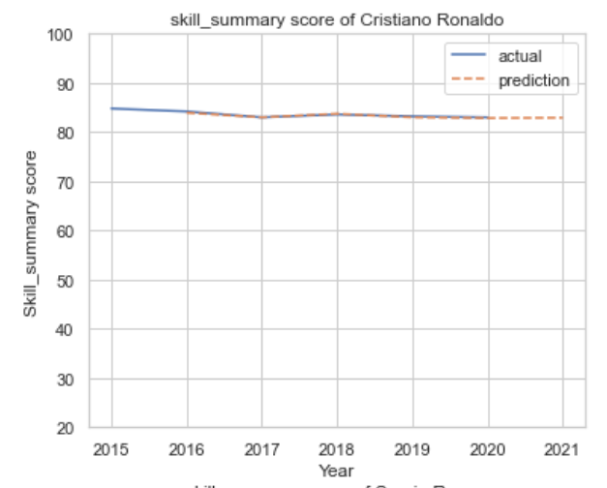
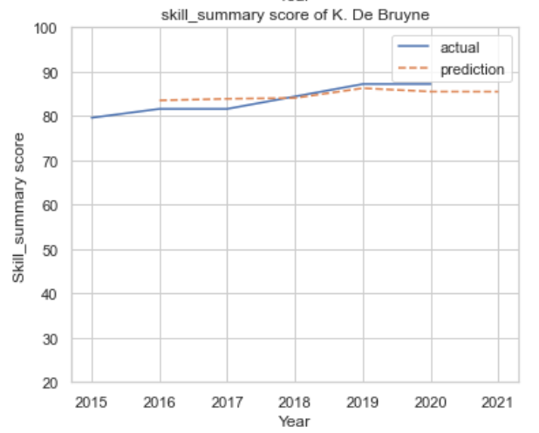
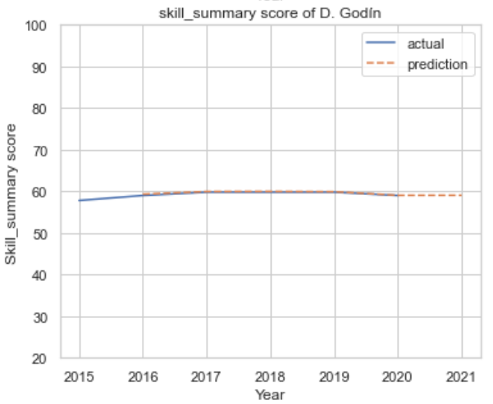
The model result (examples)
Overview
Part A
Part B
Part C
Part D
We applied the ensemble model to make prediction for skill_summary of specified players in the past years and compared them with actual result.
Cristiano Ronaldo
Kevin De Bruyne
Diego Godín

Slide 22
6. Possible Future Improvements

Slide 23
Possible Future Improvements
Do we agree with our client on definitions and methodological choices?
Could neural networks further improve predictions?

